Slide 1

Alcon: Automated Particulate Counting for Handpiece Production
Title Slide (5 pts)
• Must include title of the project, names of the students, name and affiliation of the mentor.
Optional but nice to have – logo or slogan or company name of your team.
Team:
Isaac Hoyt, Brian Ngo, Matthew Luong, Yolanda Gomez, Tandol Jerthsattayanukul, Landon Stein.
Mentors:
Tom Schacht (Sr. Manager Manufacturing Engineering),
Diego Cueto (Head of Manufacturing)

Slide 2
Alcon Handpiece
fda

Slide 3
Introduction and motivation (15 pts)
• What is the background and the problem you are addressing? Why does the problem need to be
Addressed?
Describe the problem, in-depth (pictures, stories, testimonials are great)
During manufacturing and surgery, particles can infiltrate the handpiece, leading to contamination. These particles may compromise the sterility of the device, potentially increasing the risk of post-operative complications such as infections or inflammation like endophthalmitis. [1] endo foul midas
A court case was centered around the fact that a patient contracted a form of fungal endophthalmitis post cataract surgery. In the testimony, experts testified that While the lens the surgeon inserted was identified as a potential source of the fungus, the surgical instruments were highlighted as a significant contributor, alongside other factors such as operating personnel and the operating room environment. [2]
Going more to the manufacturing side, The current particulate counting process is tedious and time consuming, which delays production and increases costs.
Background literature search1 and summary
Post-operative complications due to contamination occur in 0.04% to 0.2% of cataract surgeries but carry devastating consequences, including blindness.[3]
Studies emphasize the role of particles in infection risk, highlighting that medical devices must meet stringent cleanliness standards
Particle counting systems are crucial in manufacturing, but existing methods often rely on manual or semi-automated processes, which can be prone to human error and inefficiency
Convince the listeners why this is a problem: who does it affect, why is it a problem, how many people suffer/die, how bad is it, what is the financial/societal burden?
Patients undergoing eye surgery are most at risk. The current particle counting system slows production, creates bottlenecks, and increases costs. Any delay in delivering sterile handpieces could impact the availability of these tools in operating rooms.
Over 28 million cataract surgeries occur annually worldwide. If even 1% of these are affected by suboptimal devices, it means 280,000 people are at risk.
Where is the gap in care? Have references on your slide when you quote things
The gap lies in the lack of efficient, modernized particulate counting systems for medical device manufacturing
Who are the stakeholders: patients, doctors, first responders, caretakers?
Sources:
https://pmc.ncbi.nlm.nih.gov/articles/PMC2377378/
https://www.casemine.com/judgement/us/5914b030add7b049347516ab/amp
https://pmc.ncbi.nlm.nih.gov/articles/PMC5742953/

Slide 4
Approach
Approach (15 pts) One person outlines the approach, one person introduces ISO standards? Leads into design slide? Maybe one person talks about imaging technologies instead? (split into two slides?)
ISO 14644 – specifies the classification of air cleanliness in terms of concentration of airborne particles in medical device
USP 788 standard for particulate matter in injectables - we will use this one
• How do you plan to address the problem? What’s the proposed design? How does it work? Why
is it novel and how is it different than what’s being done now?
Problem stems from that fact that analyzing the particulates in the handpieces is a tedious and time consuming process. Specialized technicians take around 20-30 minutes evaluating each handpiece before it is ready to be sent out to surgeons, which is not scalable to meet the growing demand and will lead to bottlenecks in production.
We aim to improve the inspection process by automating the inspection process using imaging software and uploading the data into a MATLAB script that would analyze the size, shape, and type of particulate in the handpiece. If the particle count is within below certain threshold, then the software will deem the handpiece fit for use.
The novelty comes from the fact that technicians are evaluating the particles manually, but we want to build software that evaluates it automatically. Manual inspection is a labor-intensive process and an automated system will minimize the operational costs while maintaining the quality control standards.
• Particles and debris leftover after manufacturing process
• Similar to barcode device at market? Handle with built-in image processing system and real- time video of microscopic observations
I don't think that it needs to be handheld, might be better to just have a system that pulls the data from whatever microscope we end up using and processing it on a computer
We might need a physical device for preparing the sample
There are two main options: we can either rinse particles out of the filter and into a liquid sample for “light obscuration” testing
Or continually carried out during simulated use procedure
We should definitely do this one, maybe use method 2 to confirm
Method 2 is better for shape classification
Or we can use microscopes to look at the particles while they're on the filter
Paired with
• Scanning a sentry handpiece to detect particles and debris. If the the size is within the threshold that would prevent Sentry handpiece to reach its maximum functionality, box the particle and display the total count on the monitor
• Manual inspection is not process is not scalable and efficient to meet the growing demand for Alcon’s Active Sentry handpieces leading to stagnation in production line

Slide 5
Current Method: Dry visual filter analysis
Improved Method: Automated Visual inspection
Technicians manually observe for particles in the filter
Count for particles manually
Microscope equipped with high-resolution cameras to capture detailed images of filter surface
Automated systems utilize image analysis software to detect, count, categorize the particles based on the size and shape

Slide 6
What FDA class? Why? What does it do
Class II (activesentry is class II, our device doesn't have a classification but it’s involved in the manufacturing of the activesentry handpiece)
intermediate risk in the case that particulate counting device malfunctions, leading to complications in medical procedure during eye surgery.
Different imaging technologies:
particle detection using photons, particle detection using laser and light scattering, Fourier transform infrared microscopy (FTIR)
explain device:
Imaging technology
Upload to script
Output result (real-time video stream with bounding boxes around detected particles, particle count displayed)

Slide 7
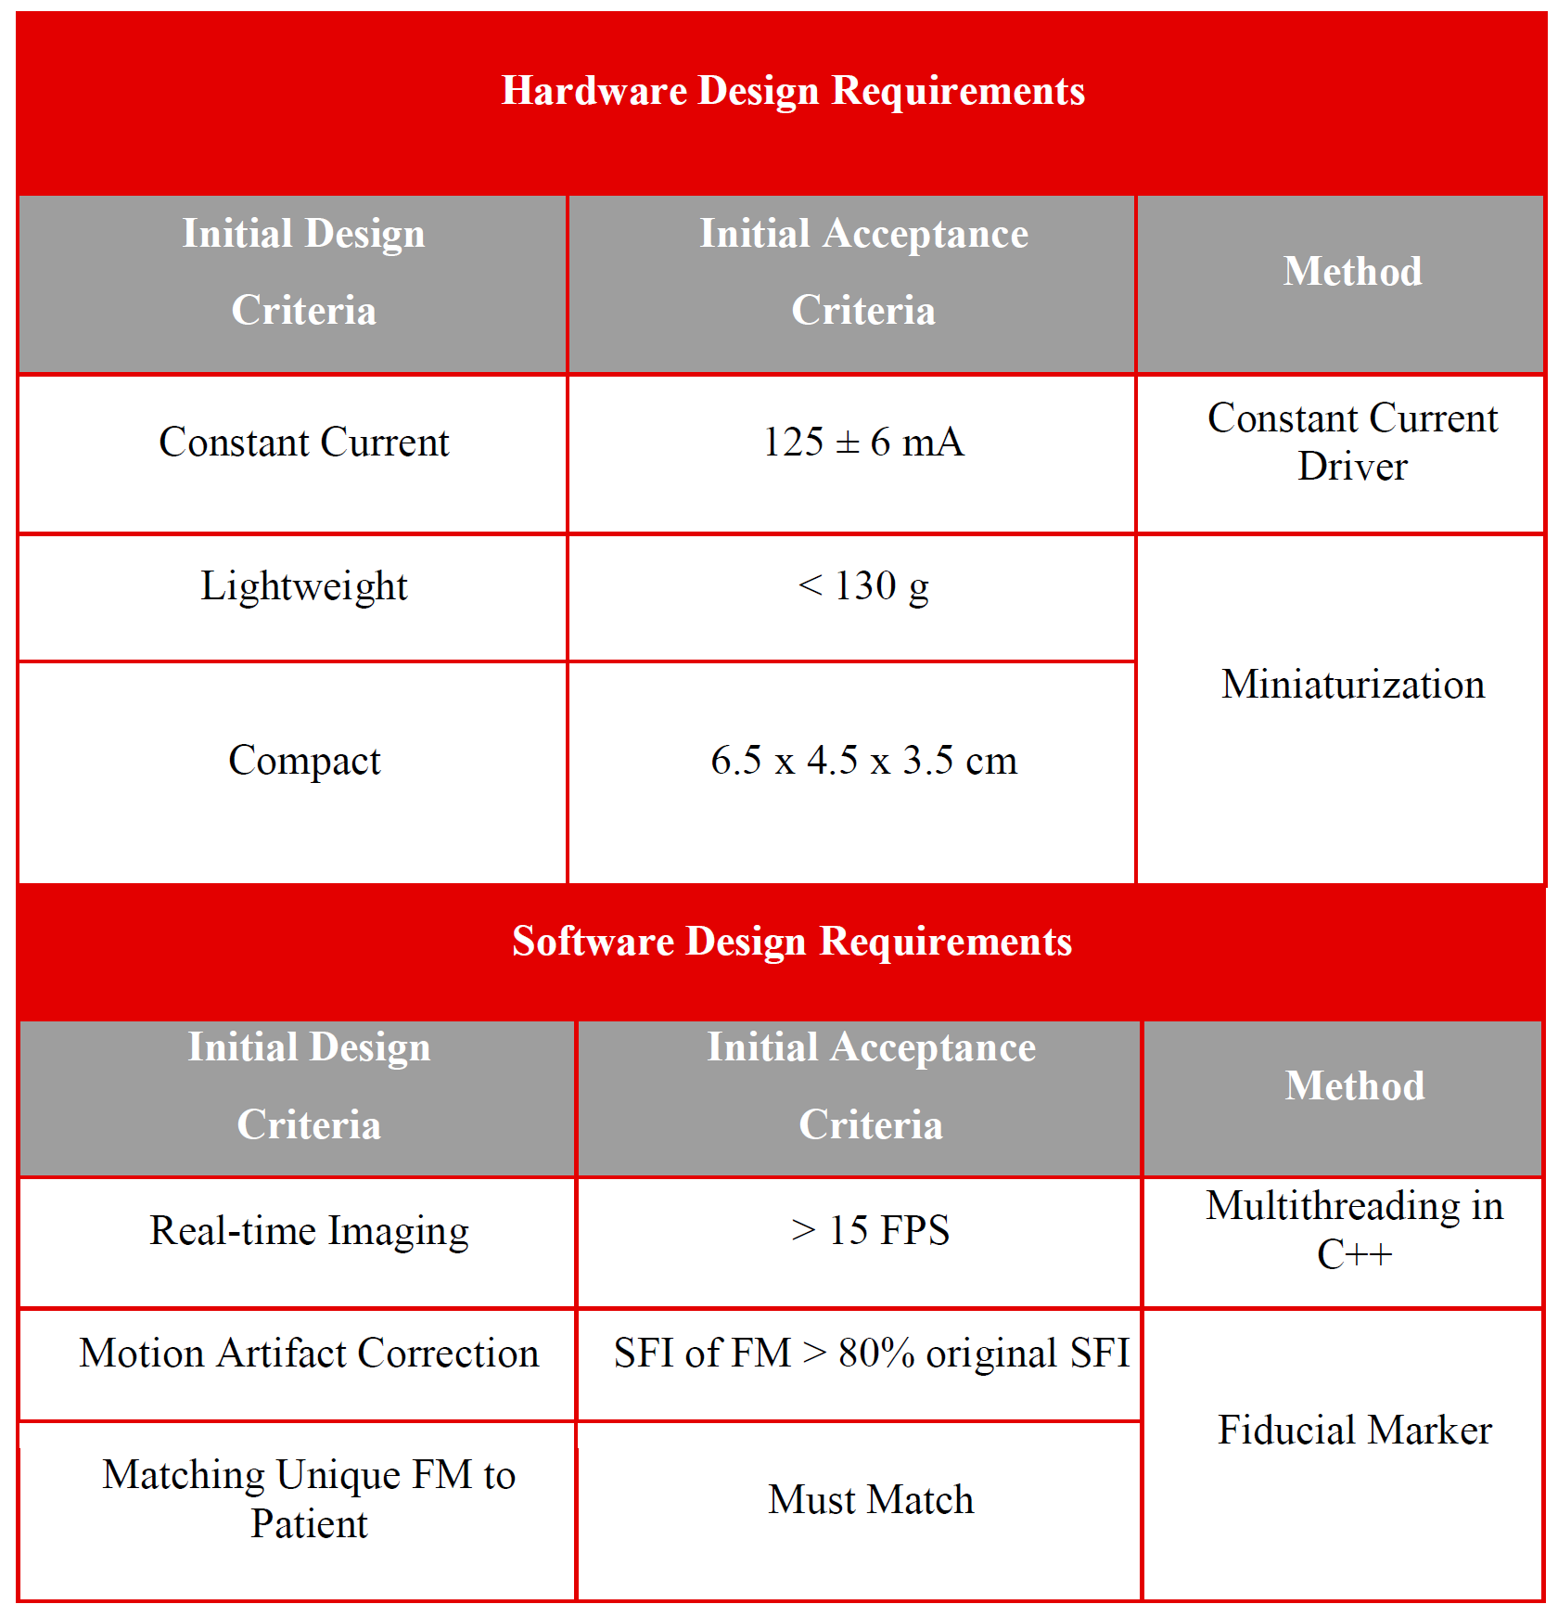
Design (30 pts) One person describes design criteria, one person describes the flowchart (split into two slides?)
• What are the design criteria (i.e., weight, portability, cost, accuracy, etc.) and acceptance criteria
(how close does your design need to be to your design criteria to “pass”)?
• Include a solid model (CAD model) of your preliminary design(s) with dimensions. If a CAD model
is not appropriate if there are no hardware components, show a model or flowchart of your
Design.
Design Criteria, based on engineering mentor input and predicate device specifications
Manufacturing quality testing device – quickly evaluates particulate count with accurate and precise measurements. Will integrate imaging technologies within device to perform counting process
Accurate (very accurate) – must be more accurate than current standard
Automatic – Decreases time needed to determine particulate count
Cheaper – Determine cost of device and relax spending where possible
Possible Standards – ISO 10993-15, USP 788, IEC 62304, ISO 16232
Form-Factor – should not be larger than current counting device
Acceptance Criteria – Device passes once it is either, more accurate with equivalent time or faster with equivalent accuracy and precision. Both outcomes should not exceed current predicate device cost.
Count and size particles
Validation: spiking and recovery, benchmark against a known predicate
flowchart/diagram of device:
Imaging technology
Upload to script
Output result
Notes:
10993 – Identification and quantification of
degradation products from metals and alloys
788 – particulate matter in injections
62304 – software life cycles processes
16232 - Cleanliness of components and systems
13485 – quality management systems for regulatory purposes
ISO 12707 - non-destructive magnetic particle testing

Slide 8
Flowchart
Sample preparation - sample imaging - sample analysis
Need to collect particles in liquid sample
Put into microscope thingy
software
Get result
Diagram showing testing, particles collect in filter, liquid sample,
Design Criteria
White-light interferometry
MATLAB Script
Output Result

Slide 9
START: Assembled Handpiece
Filter Liquid
Product Testing Station
Dry Filter
Is particle count
≤12/mL of ≥10µm,
≤2/mL of ≥25µm?
High-Pressure Liquid Pumping
Automated Image/Data Collection
Liquid Collection
Upload to Matlab
Pass
Fail

Slide 10
Team (10 pts) One person for this slide, maybe each person can introduce their own role (split into two slides?)
• Who is doing what?
Isaac team leader
Yolanda, Matthew hardware
Brian business + writing
Tandol Specific software, hardware components to design
Areas to research
Future Goals (5 pts)
• Briefly describe the goals for Winter and Spring Quarters?
Acquire imaging technology, create process to extract data, start writing script to analyze data
Outline the areas that we need to research
Imaging technology
Machine learning for particle evaluation
• Provide an updated Gantt Chart with milestones.

Slide 11
Overall Aesthetic of slides (20 pts)
• Good balance between text and figures, text size is large enough to read clearly, high‐quality
drawings, photos, and graphics, appealing design and text fonts
Stuff we need to do:
Create flowchart (biorender?)
Gantt chart - use from HW 5?

Slide 12
Sources and stuff
https://www.nelsonlabs.com/four-important-things-to-know-about-particulate-testing-and-medical-devices/
https://medinstitute.com/services/medical-device-testing/particulate-matter-testing/
https://www.uspnf.com/sites/default/files/usp_pdf/EN/USPNF/revisionGeneralChapter788.pdf
https://sentrysci.com/surface-particle-counter
https://cdn.standards.iteh.ai/samples/68937/d2812ae466d04cabaaa1958e2acdcf8b/ISO-10993-15-2019.pdf
https://www.uspnf.com/sites/default/files/usp_pdf/EN/USPNF/revisionGeneralChapter788.pdf
https://po-files.ks3-cn-beijing.ksyun.com/5f445d6af346fb3c83c3de37_6a3c46d361fc.pdf
https://cdn.standards.iteh.ai/samples/70267/4fbcc91b58d7452f8141468f8166246d/ISO-16232-2018.pdf
https://www.beckman.com/resources/industry-standards/usp-787/light-obscuration-optical-method-for-particle-detection

